Slide 1
04 Policy Gradient

Slide 2
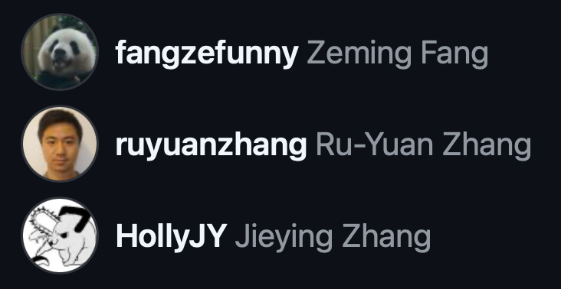
This tutorial is mainly contributed by…
Github
方泽鸣，zemingfang11@gmail.com
张洳源，ruyuanzhang@gmail.com
张洁莹，jieying.zhang@student.uva.nl
部分内容由张洳源老师正在编写的教材《认知行为的计算原理》收录： https://ruyuanzhang.gitbook.io/compmodcogpsy

Slide 3
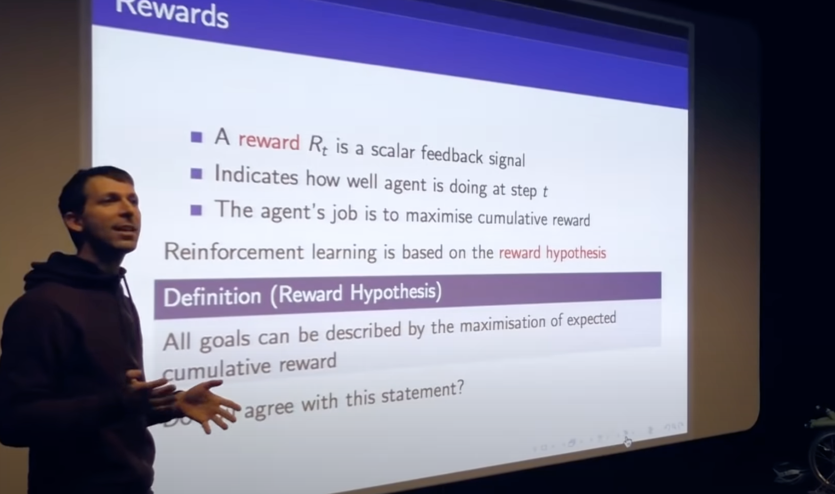
Goal: reward hypothesis

Slide 4
Definition:
Goal:
Model-based
Model-free
A lack of model
Dynamic Programming
Monte Carlo Method
Policy iteration
Value iteration
Online learning
Temporal Difference learning
Q learning
Sarsa
Continuous action spaces, stochastic policy

Slide 5
Definition:
Goal:
Model-based
Model-free
A lack of model
Dynamic Programming
Monte Carlo Method
Policy iteration
Value iteration
Online learning
Temporal Difference learning
Q learning
Sarsa
Continuous action spaces, stochastic policy
Policy Gradient Method
REINFORCE
Actor-critic

Slide 6
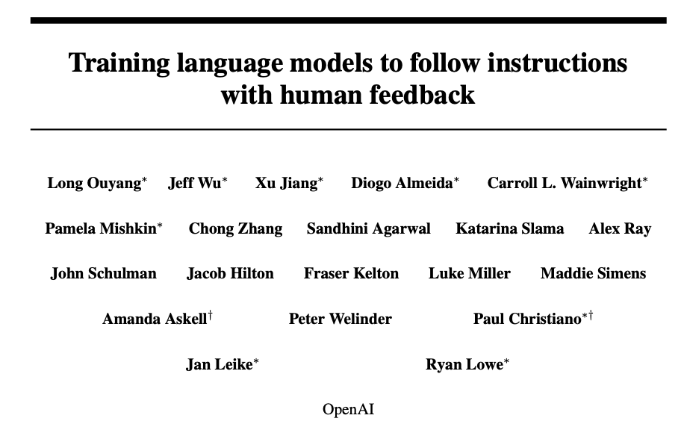
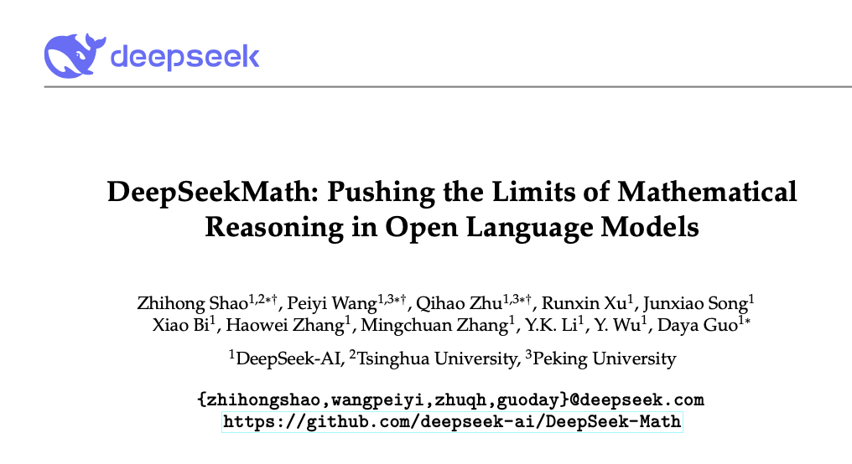
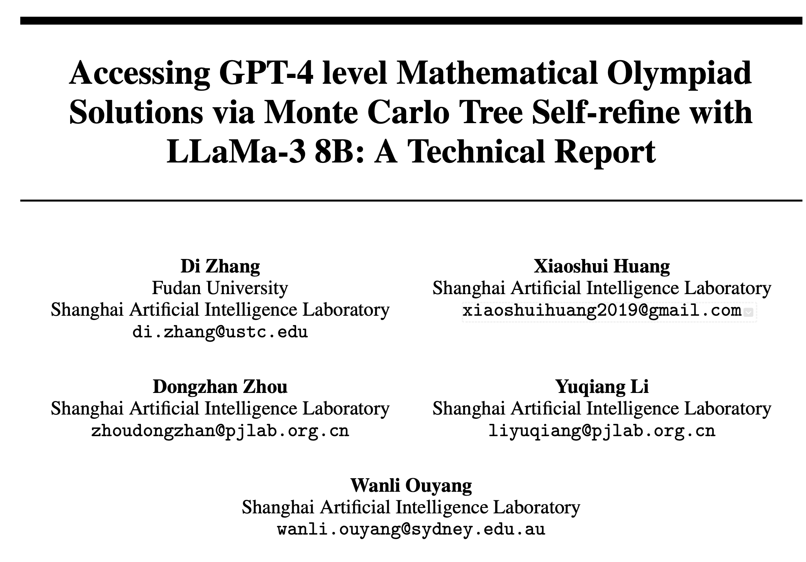
RLHF
GRPO
MCTS

Slide 7
Overview
Lecture
REINFORCE
Actor-Critic
Continuous action space
Practice REINFORCE
Actor-Critic
Advantage Actor-Critic

Slide 8
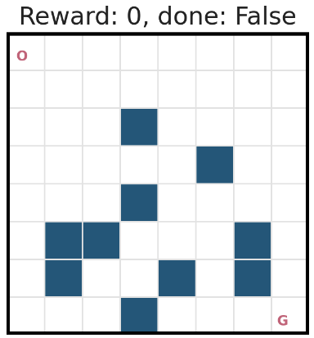
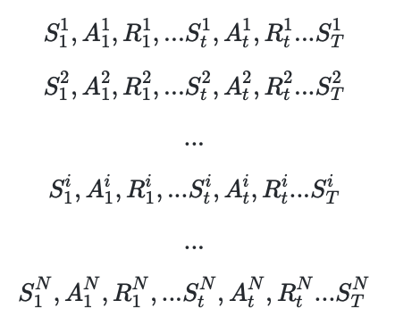
Recap: Temporal Difference method

Slide 9
Temporal Difference method
Online Learning

Slide 10

Temporal Difference method
Not an accurate approximation, due to N = 1, not
$$∞$$

Slide 11
Temporal Difference method

Slide 12
Overview
Lecture
REINFORCE
Actor-Critic
Continuous action space
Practice REINFORCE
Actor-Critic
Advantage Actor-Critic

Slide 13
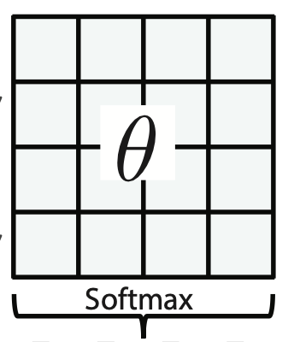
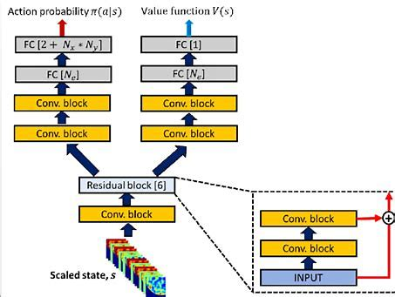
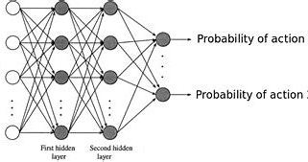
Policy Gradient: parameterized policy

Slide 14
The idea of gradient descent/ascent

Slide 15
Policy Gradient

Slide 16
Policy Gradient

Slide 17
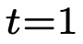
REINFORCE

Slide 18
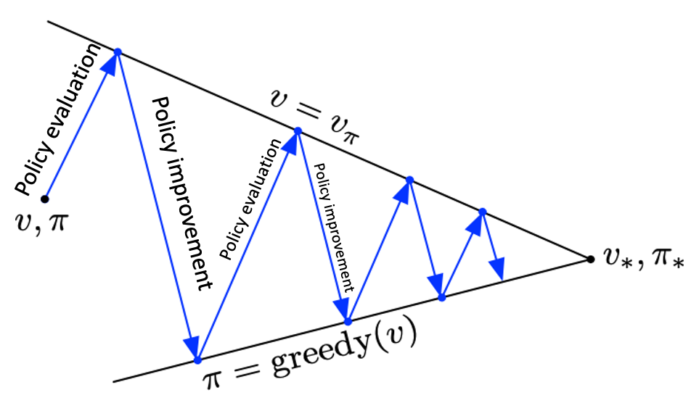
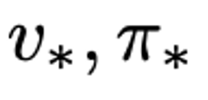
REINFORCE
Policy Iteration
Value Iteration

Slide 19
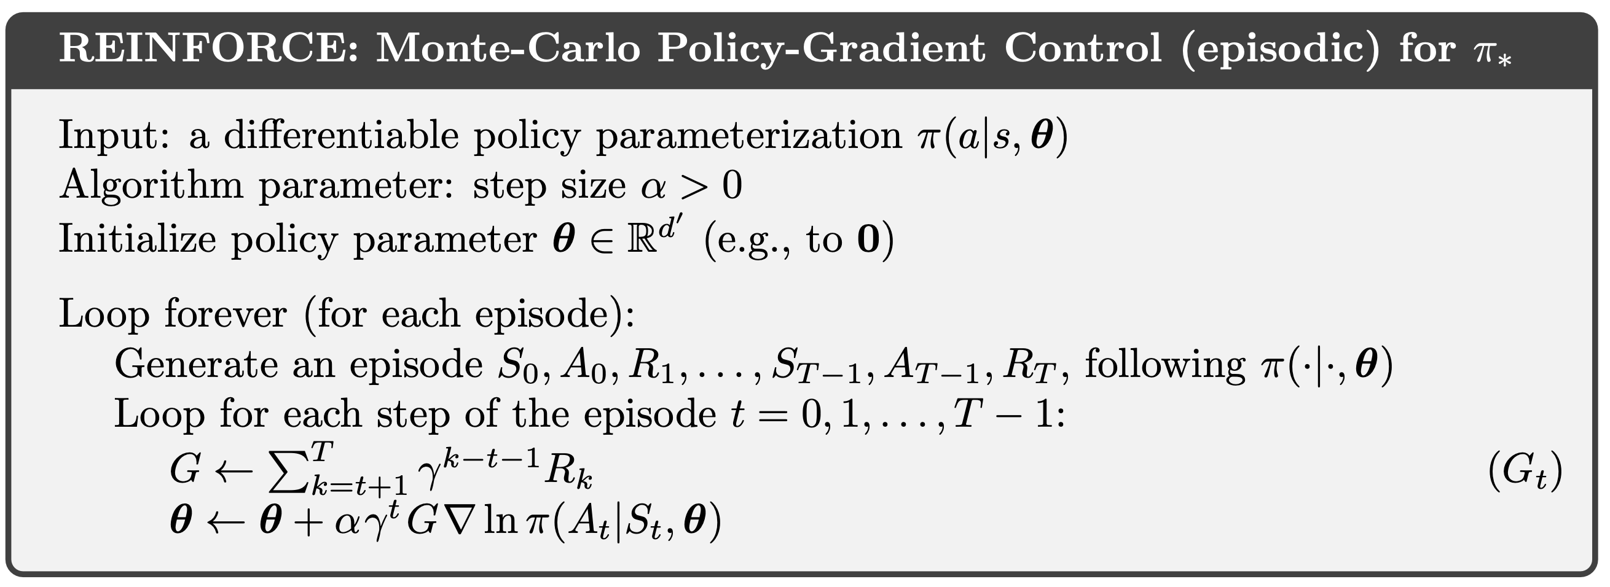
#Practice: REINFORCE
For softmax policy:

Slide 20
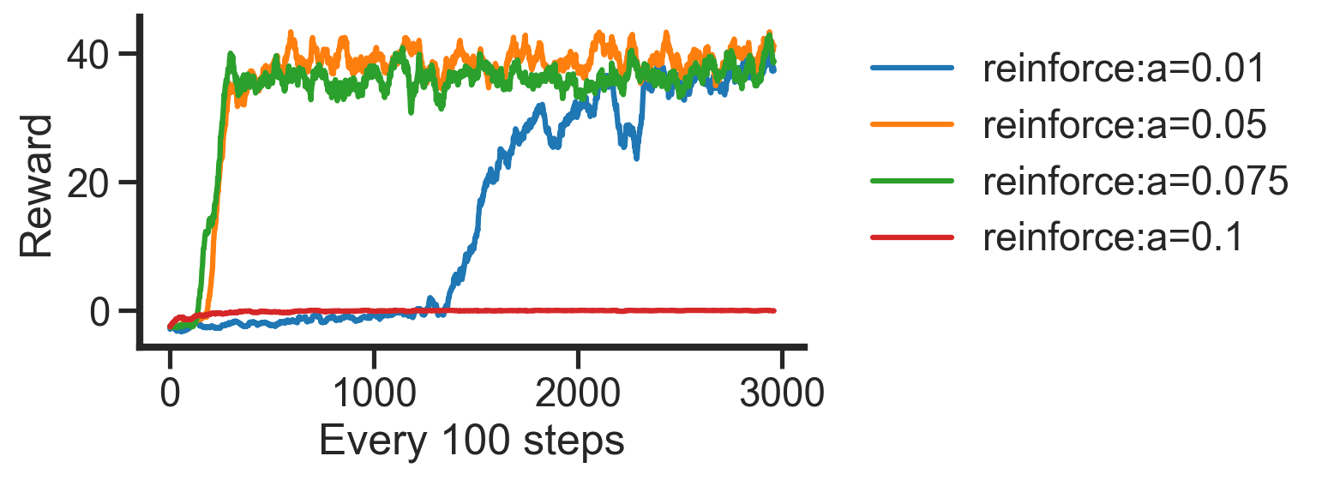
#Practice: REINFORCE

Slide 21
Overview
Lecture
REINFORCE
Actor-Critic
Continuous action space
Practice REINFORCE
Actor-Critic
Advantage Actor-Critic

Slide 22
Online Policy Gradient?
Monte Carlo
TD learning
REINFORCE
Actor-Critic

Slide 23
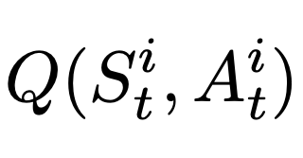
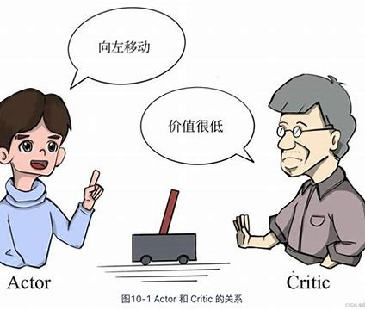

Actor-Critic
$$≈$$
See AC through another lens:

Slide 24
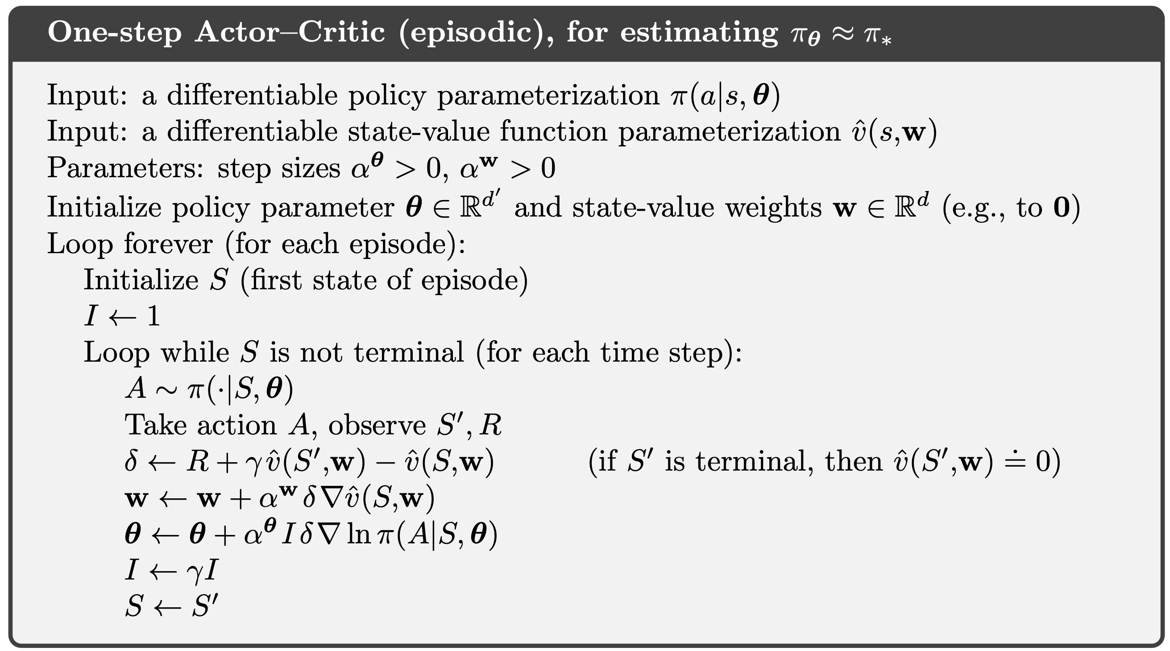
#Practice: Actor-Critic

Slide 25
#Practice: Advantage Actor-Critic

Slide 26
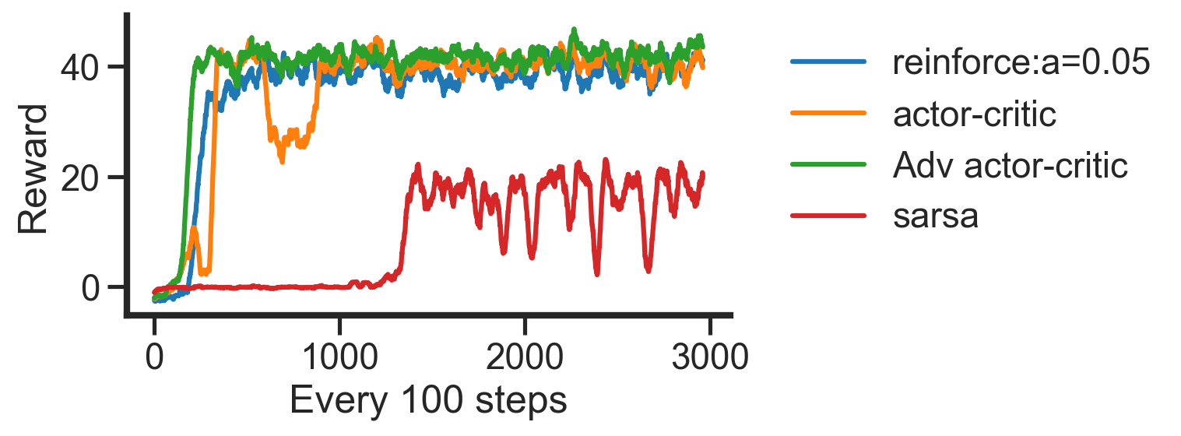
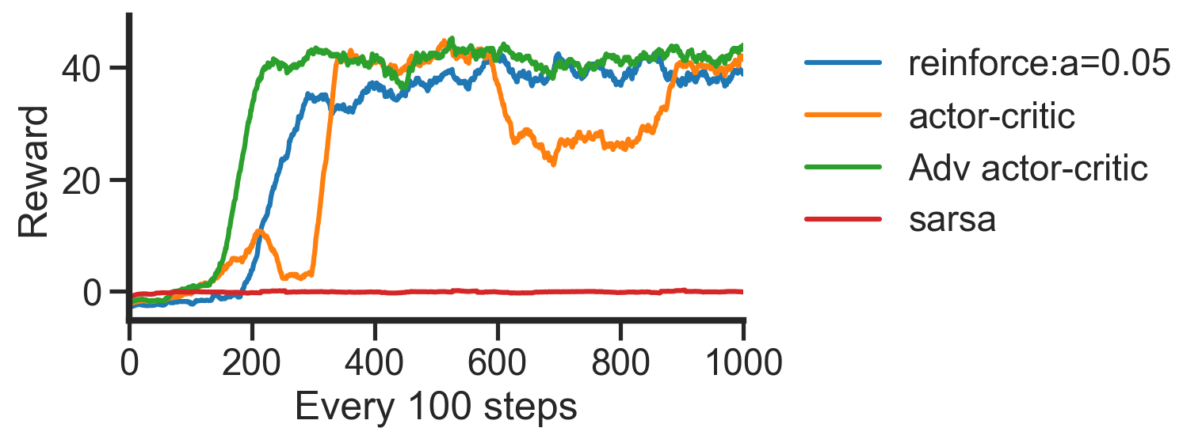
#Practice: Advantage Actor-Critic

Slide 27
Overview
Lecture
REINFORCE
Actor-Critic
Continuous action space
Practice REINFORCE
Actor-Critic
Advantage Actor-Critic

Slide 28
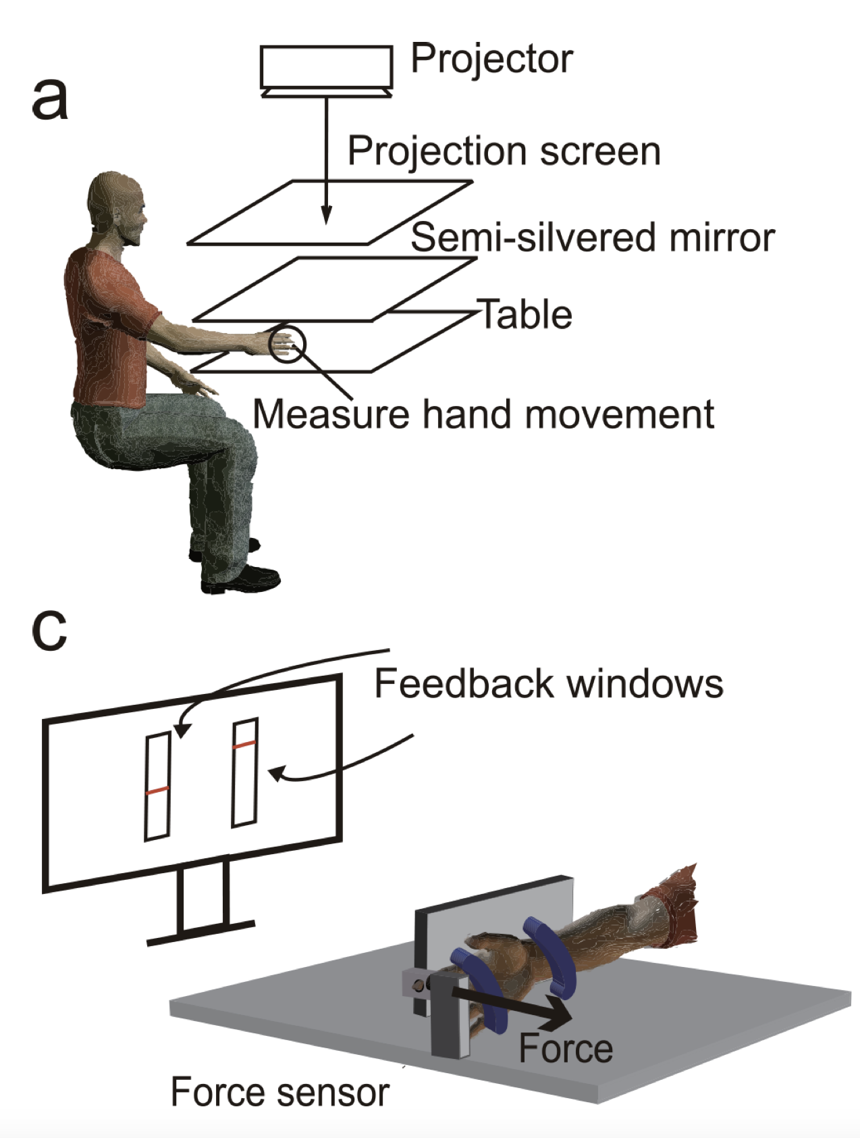

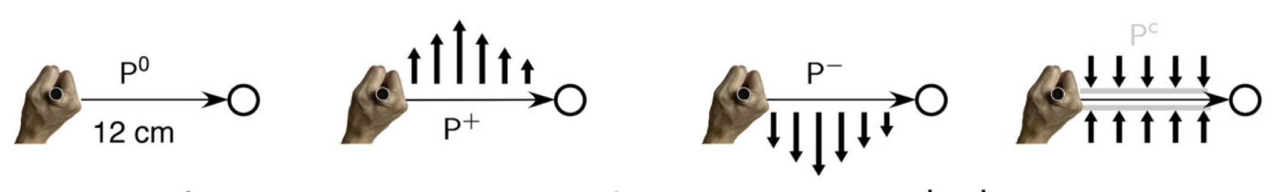
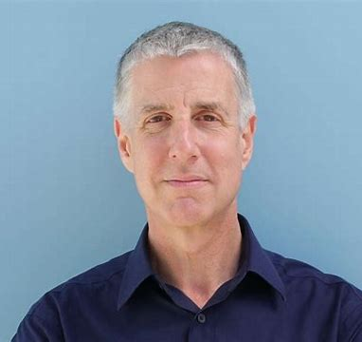
Continuous action space (motor learning)
Daniel Wolpert
Kunlin Wei

Slide 29

Cartpole environment
Action (force render to the box):
[-1, 1]

Slide 30
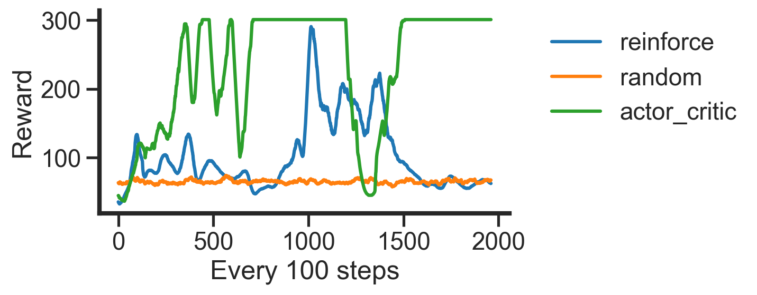
Policy gradient performance on Cartpole

Slide 31
Definition:
Goal:
Model-based
Model-free
A lack of model
Dynamic Programming
Monte Carlo Method
Policy iteration
Value iteration
Online learning
Temporal Difference learning
Q learning
Sarsa
Continuous action spaces, stochastic policy
Policy Gradient Method
REINFORCE
Actor-critic

Slide 32
Overview
Lecture
REINFORCE
Actor-Critic
Continuous action space
Practice REINFORCE
Actor-Critic
Advantage Actor-Critic

